Slide 1
Unemployment Analysis with Python

Slide 2
Objective
Analyze unemployment trends during COVID-19 using Python

Slide 3
Dataset Information
Region
Date
Estimated Unemployment Rate
Labour Participation Rate

Slide 4
Technologies Used
Python
Pandas
Matplotlib
Seaborn
Google Colab

Slide 5
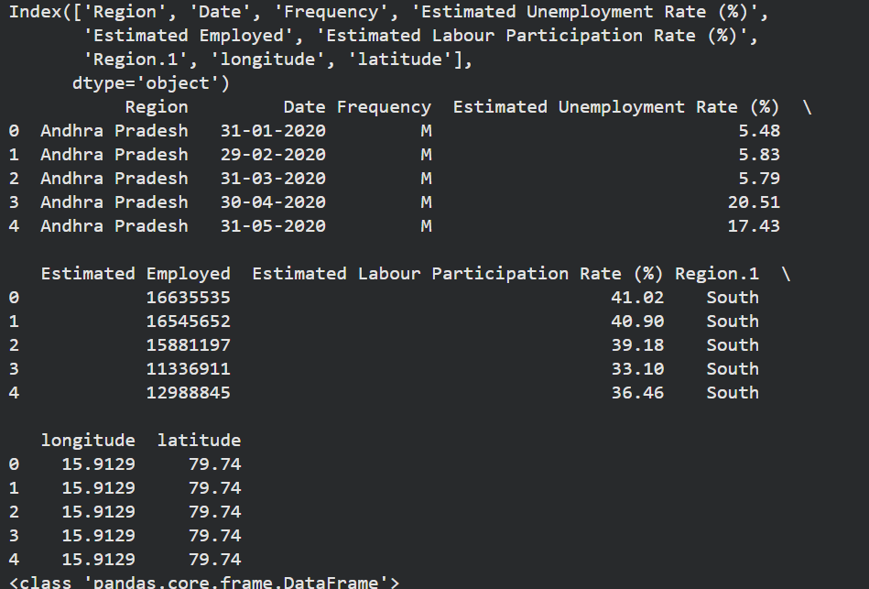
Data Exploration

Slide 6
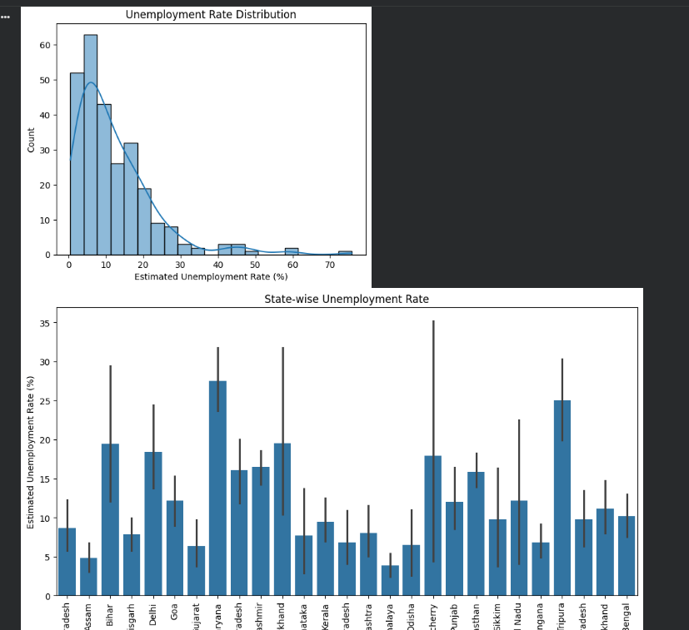
Visualization
Histogram graph
Bar graph
Line graph

Slide 7
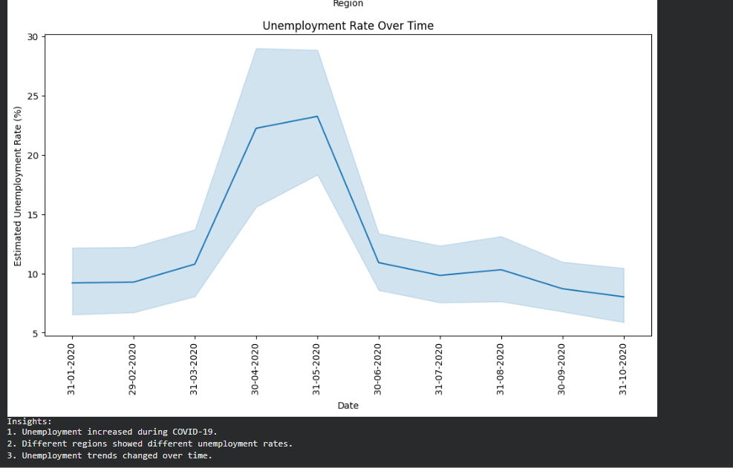
Insights
Unemployment increased during COVID-19
Different regions had different unemployment rates
Trends changed over time

Slide 8
Conclusion
Successfully analyzed unemployment trends using Python and visualization techniques

